Slide 1
EdgeGallery 容器镜像漏洞扫描方案（Proposal） Sec WG meeting 29/07/2020

Slide 2
Goal
目标:
Pre-production vulnerability analysis and policy-based security and compliance checks.
Help EdgeGallery projects better understand vulnerabilities in software packages (both OS level and 3rd party component level) used in their docker image.
Provide vulnerability fix version (if available) to help eliminate security risk.
Open source tools investigated
Anchore Engine:
Clair
Vuls.io
OpenScap

Slide 3
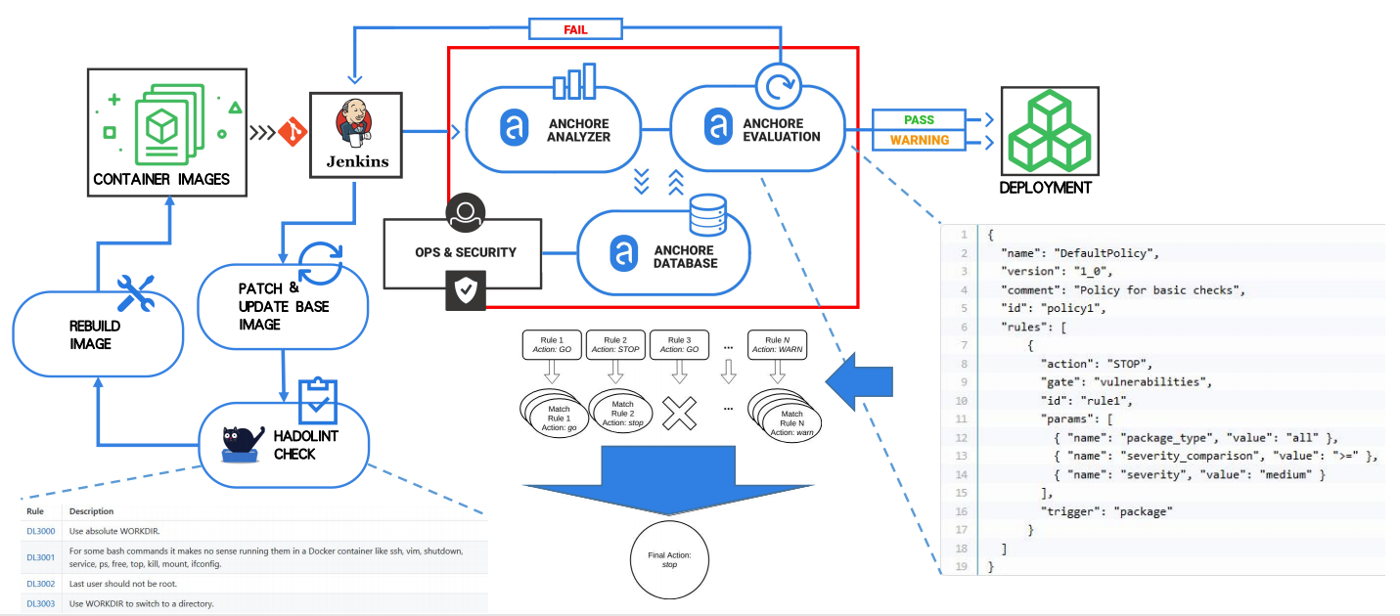
Proposed Workflow In EdgeGallery CI/CD
Phase 1
Phase 2

Slide 4
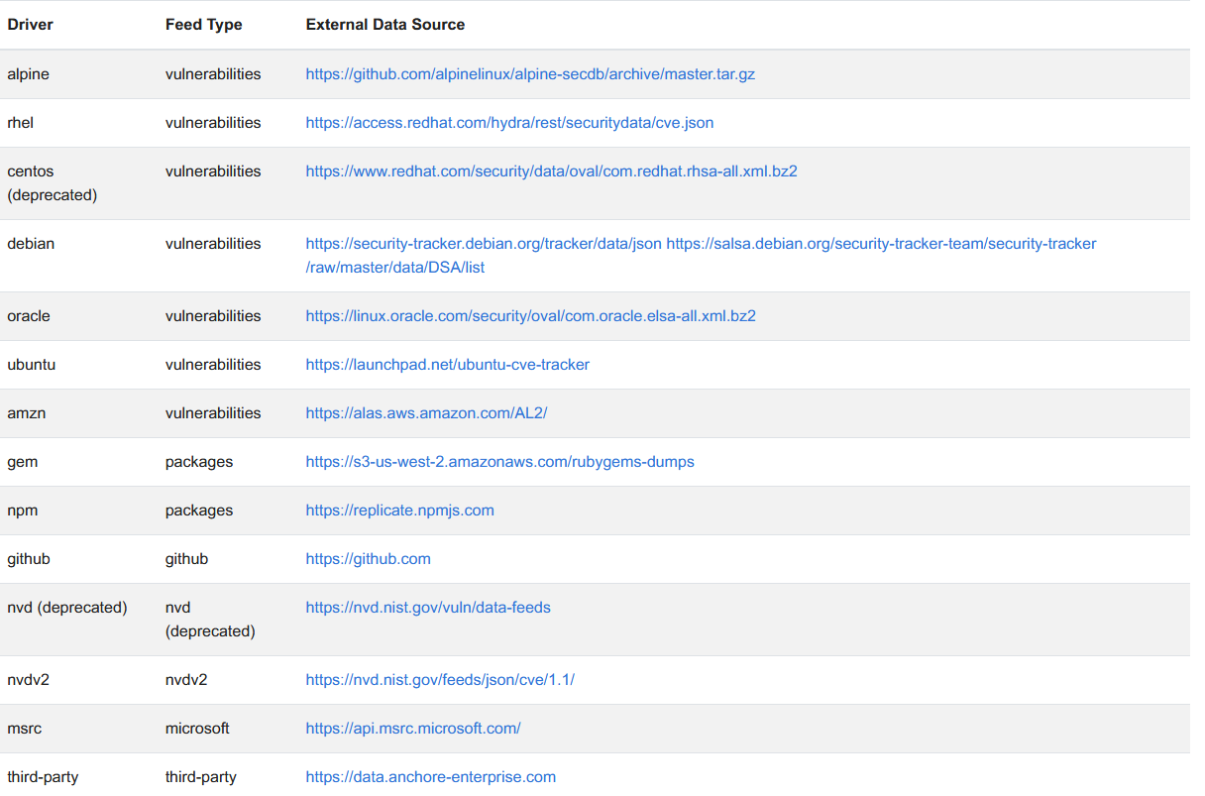
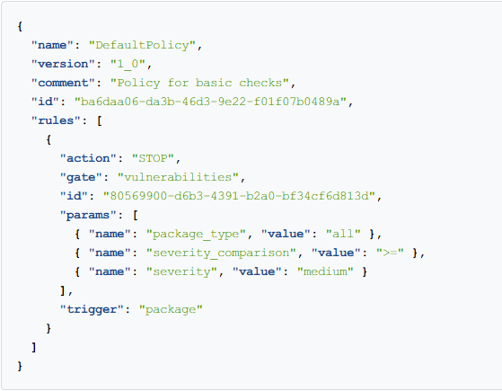
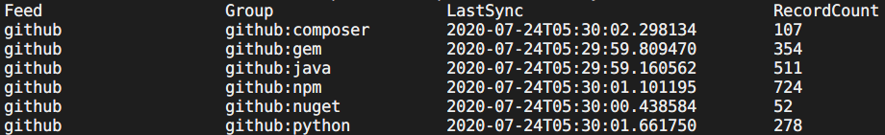
Vulnerability Feed & Evaluation Policy
Vulnerability feed covers common docker base images and software pakcge used in EdgeGallery.
Json format policy allow us to define custom policy bundle for evaluation.

Slide 5
EdgeGallery Anchore Configuration
Jenkins job setup:
One Jenkins job for each EdgeGallery PT
Image evaluation policy：
edgegallery_default_bundle (based on anchore_default_bundle)
other available policy: anchore_security_only, anchore_cis_1.13.0_base
Vulnerability fixing criteria:
All vulnerabilities with a CVSS score higher than or equal to 7.0 brought dy direct dependencies (fix available) should be fixed
Scanning period:
weekly
Additioanl checks can be added:
non-root user check
port blacklist check
dependency license check

